Slide 1
Threads
A thread is a light weight process.
A thread is a basic unit of CPU utilization, it comprises ;
Thread ID
Program counter
Register set
Stack

Slide 2
Single Threaded and Multi Threaded Process
Many software packages that run on modern desktop PCs are multithreaded. An application typically is implemented as a separate process with several threads of control.
For example, a word processor ;
A thread for displaying graphics.
Another thread for responding to keystrokes from the user.
And third thread for performing spelling and grammar checking in the background.

Slide 3
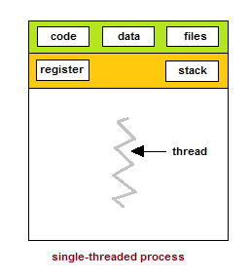
Single Threaded Process

Slide 4
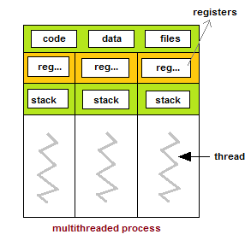
Multi Threaded Process

Slide 5
Benefits of Multithreaded Programming
There are five major benefits of multithreaded programming.
Responsiveness.
Resource sharing
Economy
Scalability
Less communication overheads

Slide 6
Responsiveness
Multithreading increase the responsiveness to the user. Multithreading may allow a program to continue running even if part of it is blocked or is performing a lengthy operation.
For instance, a multithreaded web browser could allow user interaction in one thread while an image was being loaded in another thread.

Slide 7
Resource Sharing
Threads share the memory and the resources of the process to which they belong by default.
The benefit of sharing code and data is that it allows an application to have several different threads of activity within the same address space.

Slide 8
Economy
Allocating memory and resources for process creation is costly.
Thread share the resources of the process to which they belong, so it is more economical to create thread.
It is much more time consuming to create and manage process than thread.
For e.g Solaris, creating a process is about thirty times slower than is creating a thread.

Slide 9
Scalability
The benefits of multithreading can be greatly increased in a multiprocessor architecture, where threads may be running in parallel on different processors.
A single threaded process can only run on one processor, regardless how many are available.

Slide 10
Less Communication Overheads
Communicating between the threads of one process is simple because the threads share everything, address space.
So, data produced by one thread is immediately available to all the other threads.

Slide 11
Single Core and Multi Core System
A recent trend in system design has been to place multiple computing cores on a single chip, where each core appears as a separate processor to the operating system.
Multithreaded programming provides the mechanism for more efficient use of multi-cores and improved concurrency.

Slide 12
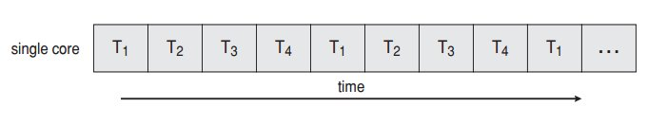
Thread Execution on Single Core System
Consider an application with four threads
(T1, T2, T3 and T4). On a system with a single computing core, concurrency merely means that the execution of a threads will be interleaved over time, as the processing core is capable of executing only one thread at a time. As shown in figure below;

Slide 13
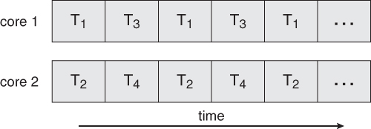
Thread Execution on Single Multiple Core System
On a system with multiple cores, however , concurrency means that the thread can run in parallel, as the system can assign a separate thread to each core.

Slide 14
Thread Library
A thread library provides the programmer with an Application programming interface (API) for creating and managing threads.
Thread library contain code for;
Creating and destroying threads.
Passing messages and data between threads
Scheduling thread executing
Saving and restoring thread contexts

Slide 15
Kernel Threads
Kernel threads exist within the context of a process and provide the operating system the means to address and execute smaller segments of the process.
It also enables programs to take advantage of capabilities provided by the hardware for concurrent and parallel processing.
Kernel threads are supported and managed directly by the operating system.

Slide 16
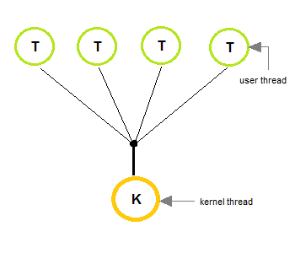
Multithreading Models (Many-To-One Model)
In many-to-one model, many user level threads are map to one kernel thread.
Thread management is done by the thread library in user space.
This model is efficient , but the entire process will block if a thread makes a blocking system call.
Only one thread can access the kernel at a time, multiple threads are unable to run in parallel on multiprocessors.

Slide 17
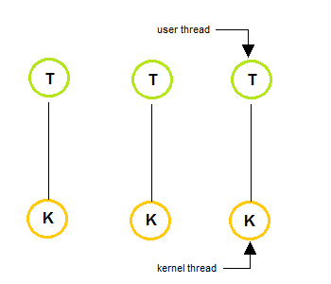
Multithreading Models (One-To-One Model)
In one-to-one model, each user thread map to kernel thread.
It provides more concurrency than many-to-one model by allowing another thread to run when a thread makes a blocking system call.
This model allows running multiple threads on multiprocessor system.

Slide 18
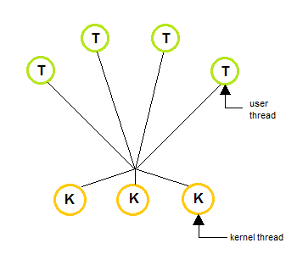
Multithreading Models (Many-To-Many Model)
The many-to-many multiplexes many user level threads to a smaller or equal number of kernel threads.
In many-to-many model, when a thread performs a blocking system call, the kernel can schedule another thread for execution.

